Slide 1

GOLD PRICE FORECASTING
Group-1
Pranjal Deshmukh
Akshay Patil
Md Faiz Kounain
Manisha Navale
Piyush Dhakate
Purushotham Pentakota
Tejasvi Kotkar

Slide 2
Objective:
To understand the underlying structure in dataset and come up with a suitable forecasting model which can effectively forecast gold prices for the next 30 days.

Slide 3
Dataset Details:
The data set which is given contains date and price of gold
We observed that the provided price of gold is for 22 carat 1gm. Gold price in India.
There are no null values and duplicated records
Date column is a date series and price is in Rs.
Further we tried to visualize the data to study patterns and fluctuations in gold prices with time
date | price
2016-01-01 | 2252.6
2016-01-02 | 2454.5
2016-01-03 | 2708.1
2016-01-04 | 2577.8
2016-01-05 | 2597.75
Sample data (first five records)

Slide 4
Descriptive statistics :
index | count | mean | std | min | 25% | 50% | 75% | max
price | 2182.0 | 3284.450 | 719.5468 | 2252.6 | 2697.02 | 2879.8 | 4147.325 | 4966.3
From the above table we can observe values of different descriptive statistics such as mean , minimum , maximum price etc.
Minimum price was recorded on 01-01-2016
Maximum price was recorded on 08-06-2020

Slide 5
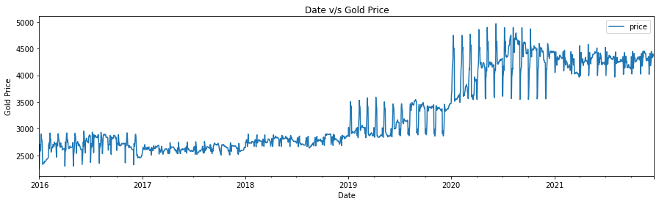
Data Visualization:
Observation:
Drastic increase in gold price after 2020
Intermediate fluctuations after 2021

Slide 6
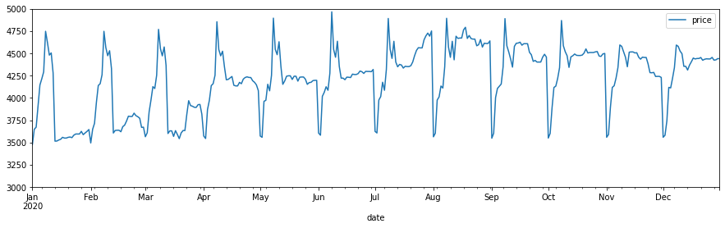
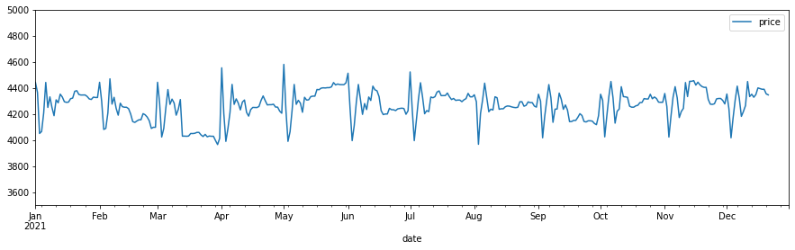
Gold prices for year 2020
Gold prices for year 2021

Slide 7
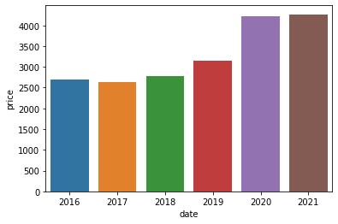
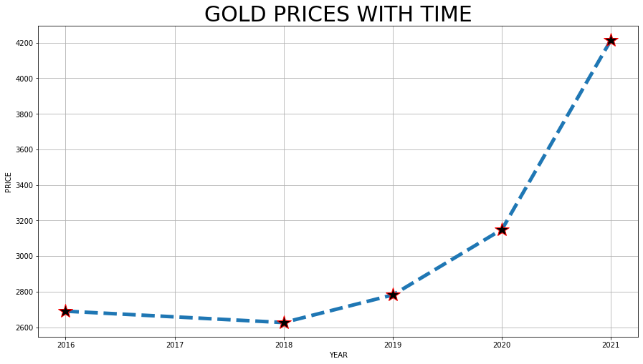
Cumulative price with time:
Year-wise average gold prices
Year-wise average gold prices

Slide 8
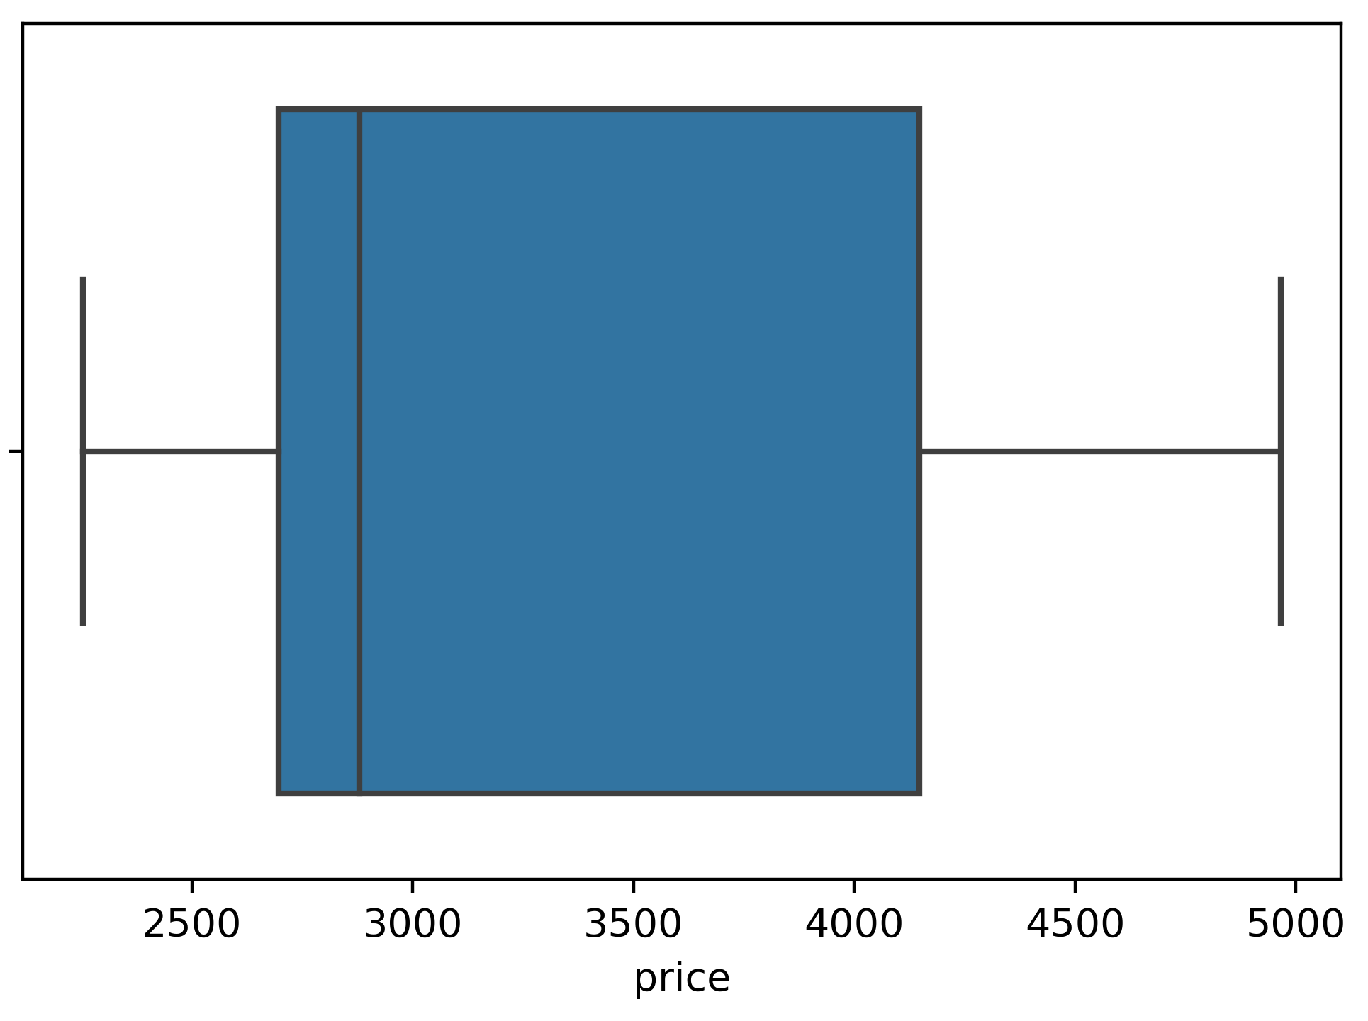
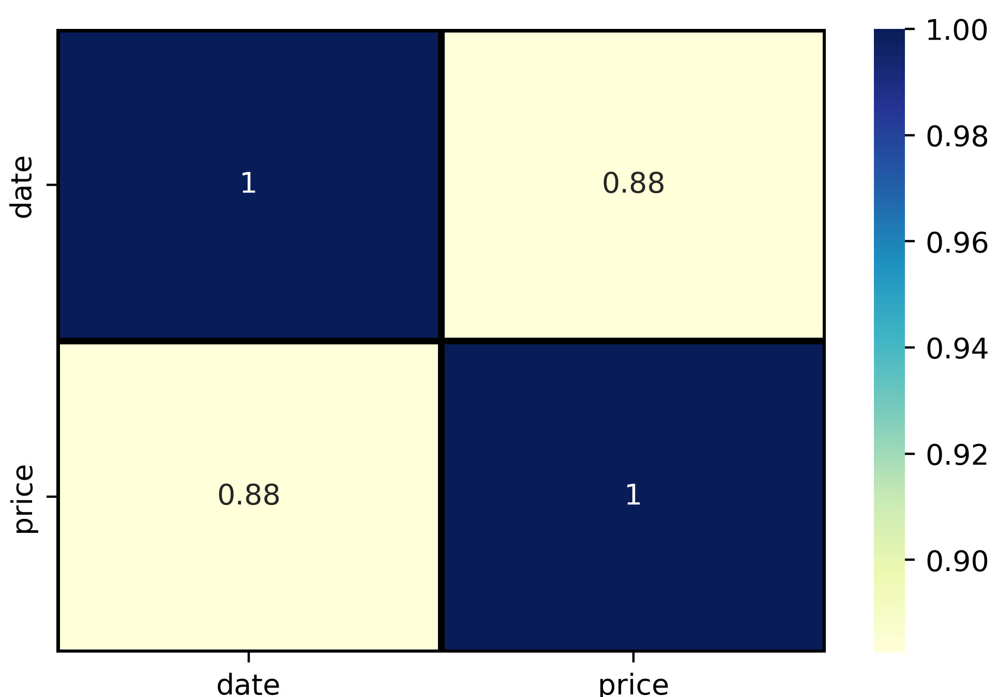
Outliers (&) correlation :
Box plot for gold price
No outliers
Median Rs. 2879.8
Year-wise average gold prices
The correlation for price and date is 0.88

Slide 9
Stationarity and Seasonality of Time Series :

Slide 10
Original Time Series
ADF Statistic: -0.3099
p-value: 0.9240
Dickey-Fuller Test for Stationarity
Difference with lag 1
ADF Statistic: -21.6645
p-value: 0.0
Difference with lag 2 ADF Statistic: -16.2990
p-value: 3.2816e-29

Slide 11
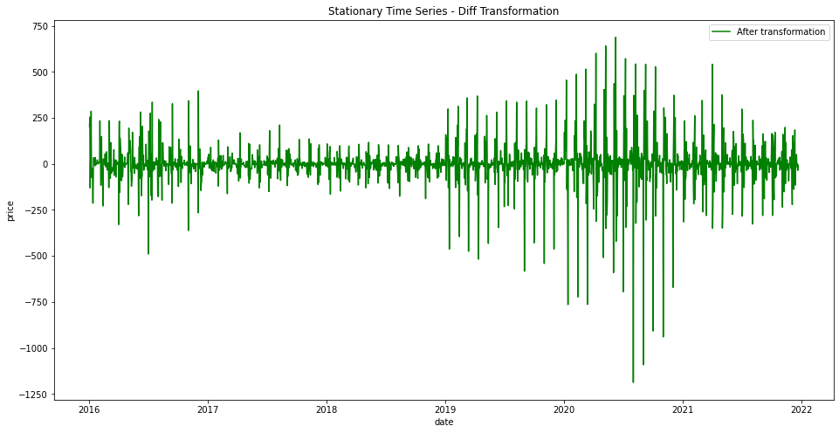
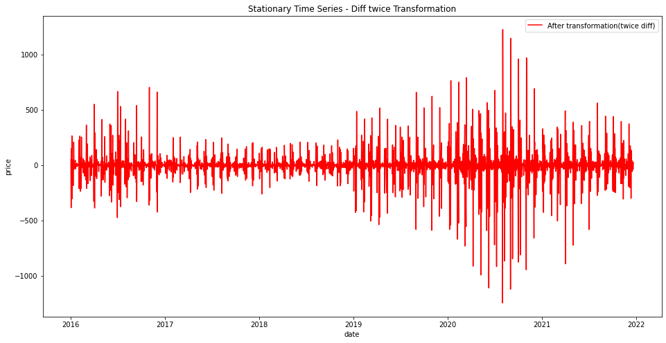

Slide 12
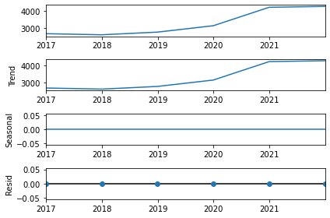
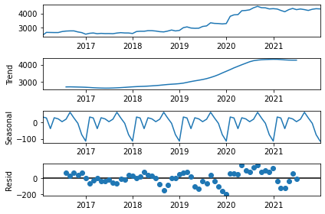
Month-wise Seasonality
Year-wise Seasonality

Slide 13
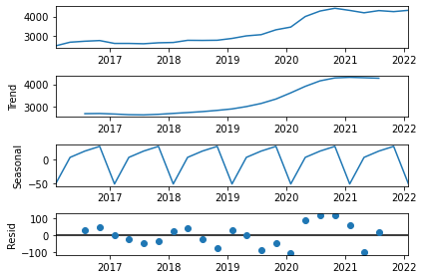
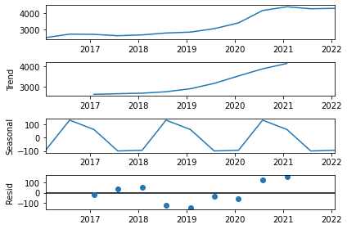
Quarter-wise Seasonality
Half year-wise Seasonality

Slide 14
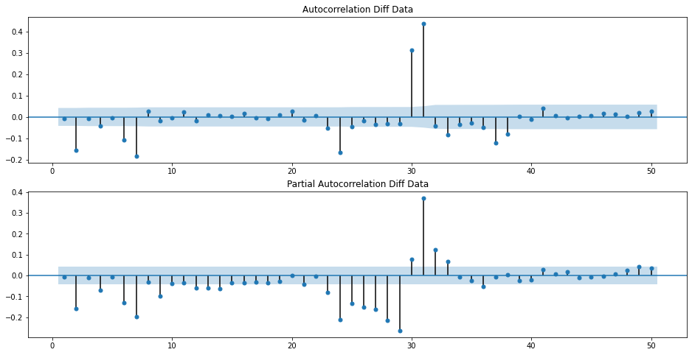
ACF and PACF graph for data with differencing lag 1

Slide 15
Model Building:

Slide 16
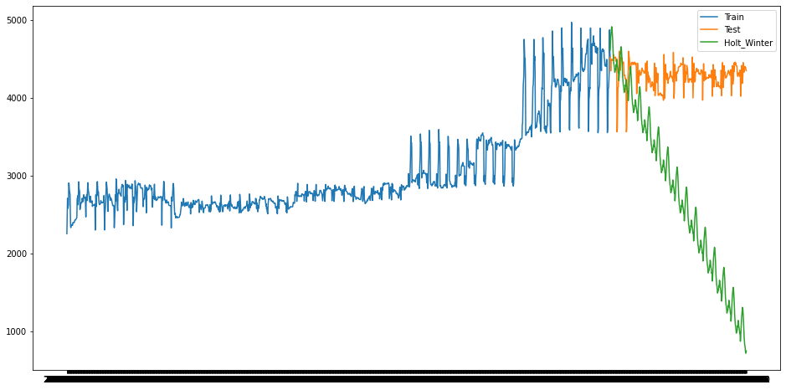
Holt Winter’s Model:
Holt-Winters model :
MAPE: 0.6366

Slide 17
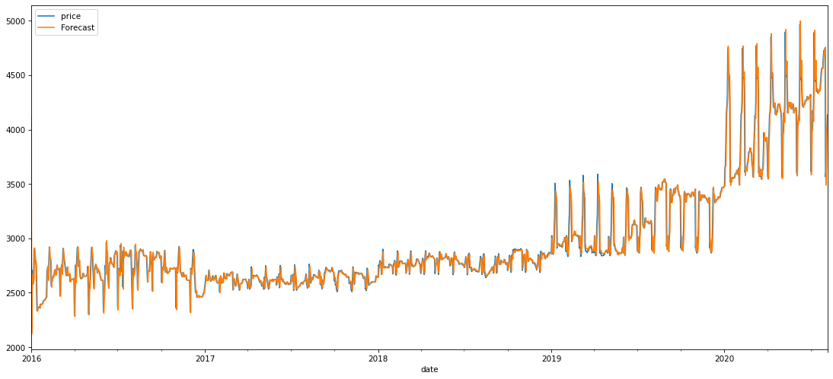
ARIMA Model
ARIMA Model:
ARIMA(1,1,1)
RMSE : 114.24

Slide 18
Gold Price Forecasted Values
Date | Price
2021-12-22 | 4341.424327
2021-12-23 | 4346.958
2021-12-24 | 4379.806491
2021-12-25 | 4377.707414
2021-12-26 | 4379.435453
2021-12-27 | 4417.744796
2021-12-28 | 4380.648329
2021-12-29 | 4335.998410
2021-12-30 | 4325.695248
2021-12-31 | 4316.335167
2021-01-01 | 4312.183089
2021-01-02 | 4284.566870
2021-01-03 | 4307.348099
2021-01-04 | 4334.167960
2021-01-05 | 4386.239125
Date | Price
2022-01-06 | 4455.680774
2022-01-07 | 4539.606239
2022-01-08 | 4590.103147
2022-01-09 | 4618.427057
2022-01-10 | 4588.919074
2022-01-11 | 4495.647417
2022-01-12 | 4408.906208
2022-01-13 | 4287.362337
2022-01-14 | 4197.269695
2022-01-15 | 4140.990343
2022-01-16 | 4099.603359
2022-01-17 | 4072.333489
2022-01-18 | 4042.996939
2022-01-19 | 4013.829178
2022-01-20 | 4020.380293

Slide 19
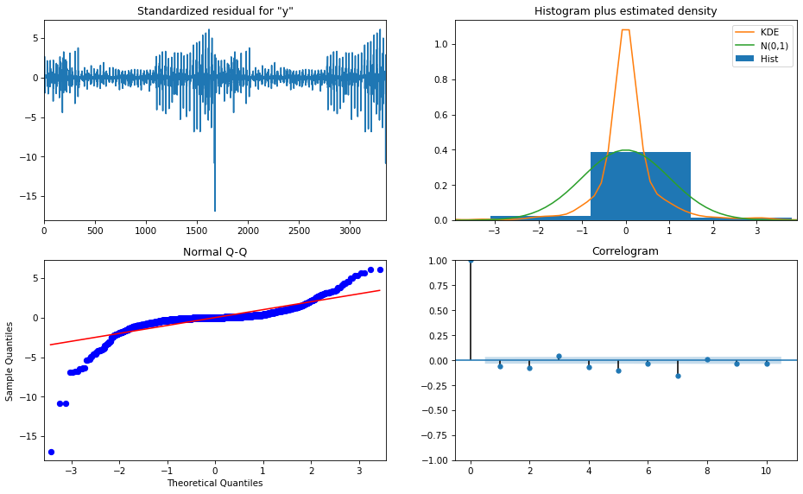
ARIMA Model Evaluation

Slide 20
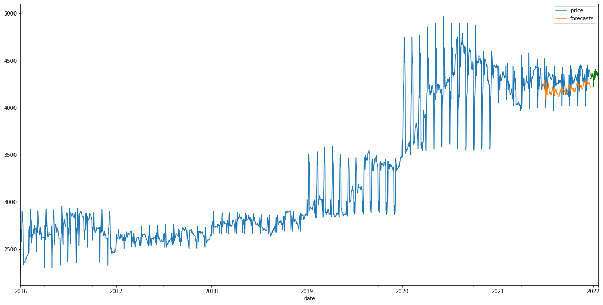
SARIMA Model
SARIMA model:
SARIMA(0,1,3) x (0,1,3,30)
RMSE: 108.9492

Slide 21
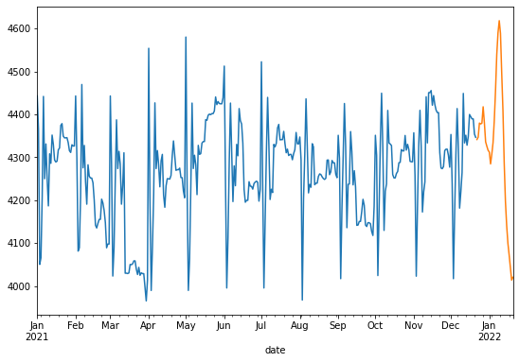
Gold Price Forecasting for next 30 days

Slide 22
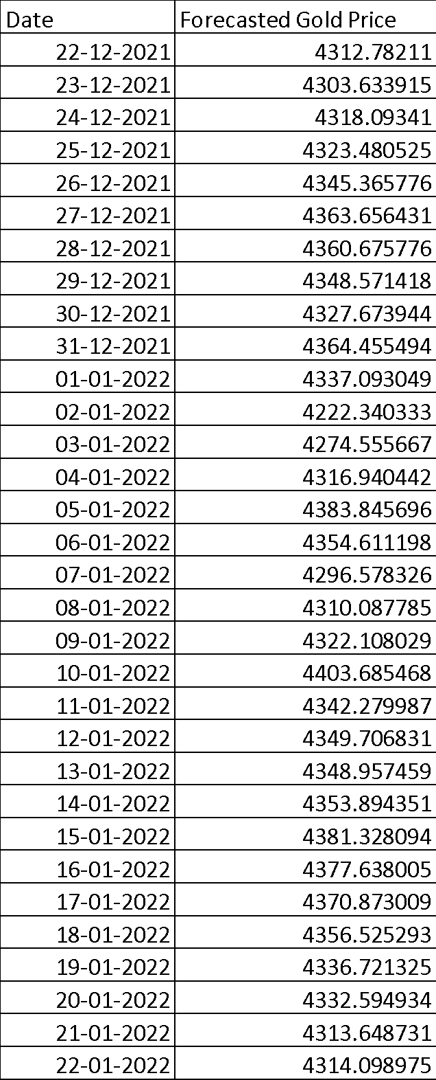
Forecasted Gold Prices for next 30 days (using SARIMA model)

Slide 23
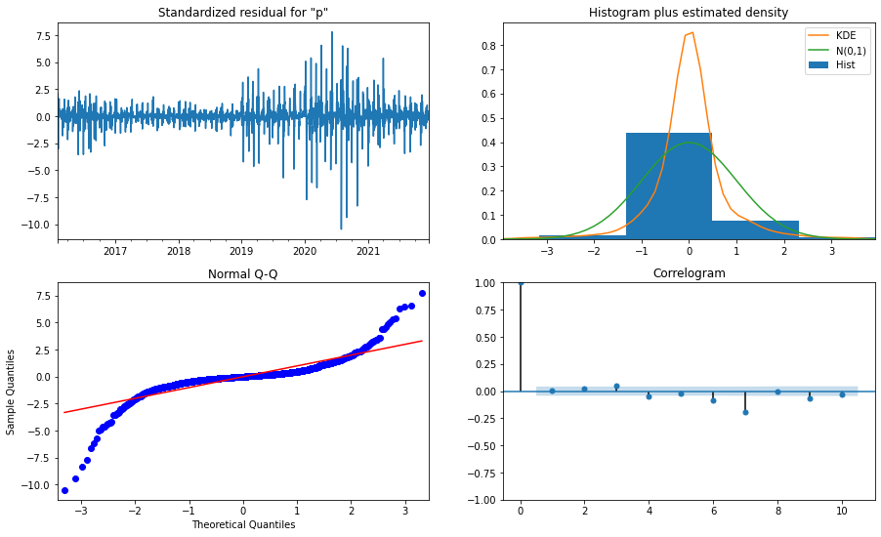
SARIMA MODEL EVALUATION

Slide 24
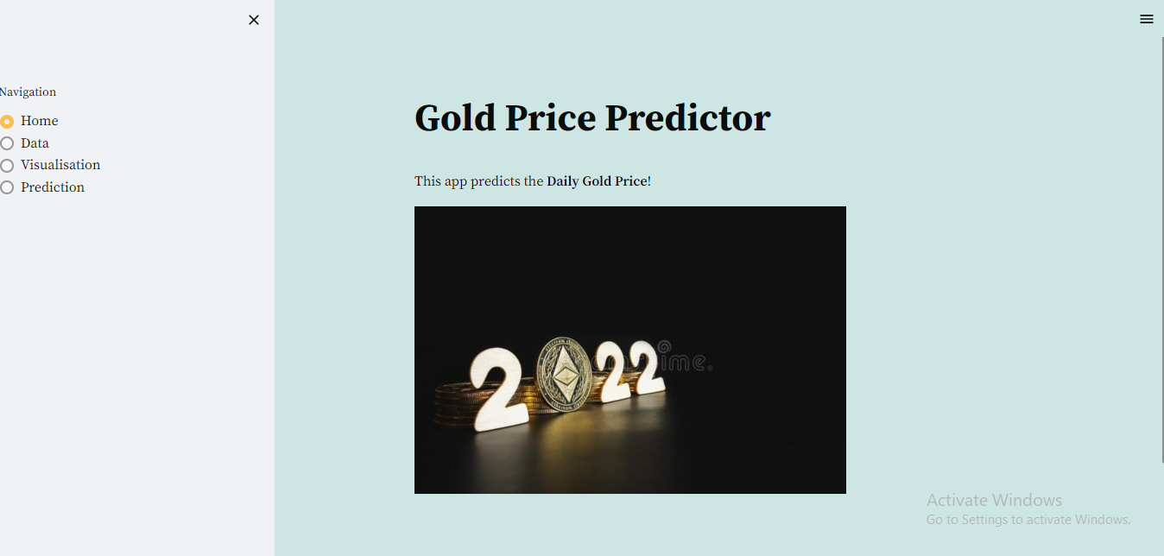
Deployment:

Slide 25
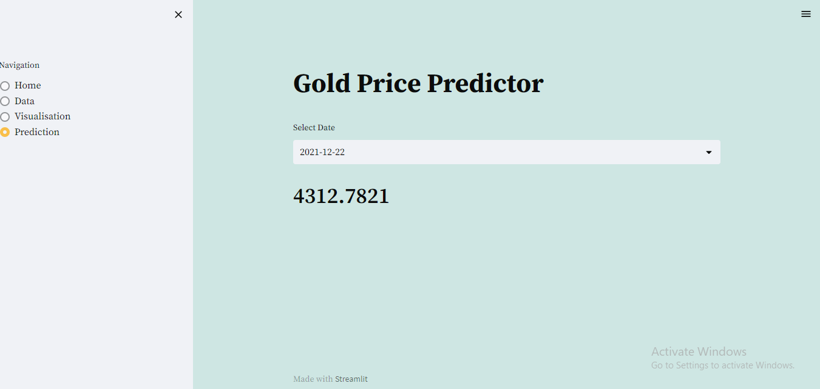

Slide 26
Challenges faced:
To decide the parameters of SARIMA Model.
Deployment was taking too much time for loading the visualization graphs.
How did you overcome:
We tried to fit 2 or 3 models then with the help of ACF and PACF plots decided the final model.
We uploaded images of the graphs from python file.

Slide 27
Thank you

